Slide 1

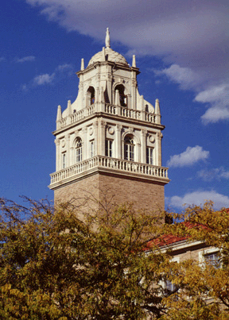
HPCViz: Monitoring Health Status of High Performance Computing Systems
Presenter
Dr. Tommy Dang
Assistant Professor, Texas Tech University
Faculty
Dr. Yong Chen
Associate Professor, Texas Tech University
Dr. Allen Sill
HPCC Managing Director, Texas Tech University
Industry
Jon Hass
Software Architect at Dell Inc.
PhD Students
Vinh Nguyen
Ghazanfar Ali
Vung Pham

Slide 2
Outline
Introduction
Background and related work
Visualization architecture: Why Multidimensional analysis?
Demo
Future work

Slide 3
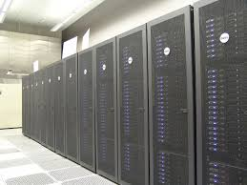



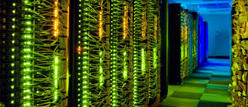
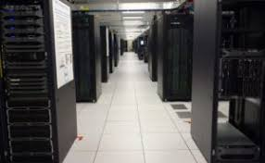
Introduction
Introduction
HPCC – Texas Tech University
Hewlett Packard Enterprise
IBM.com
Intel.com
HPC - Southern California
Dell EMC

Slide 4
Project Overview
Monitoring data centers is challenging due to their size, complexity, and dynamic nature.
This project proposes visual approaches health service monitoring of HPC systems.
The visualization is expanded on the following dimensions:
HPC spatial layout
Temporal domain (historical vs. real-time tracking)
System health services such as temperature, memory usage, fan speed, and power consumption.

Slide 5
Project Overview
We therefore focus the following design goals:
Provides spatial and temporal overview across hosts and racks,
An interface that allows viewers to quickly narrow down features or event of interest
Easy to switch and compare between different health status of HPC centers

Slide 6
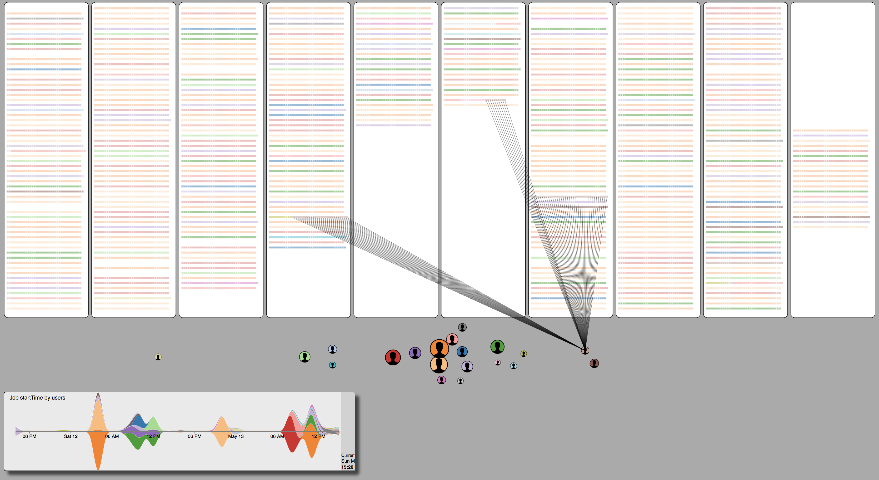

HPCC spatial layout and job scheduling
Scan the bar code using your phone camera to run our visualization
Demo: https://idatavisualizationlab.github.io/HPCC/scheduling/

Slide 7
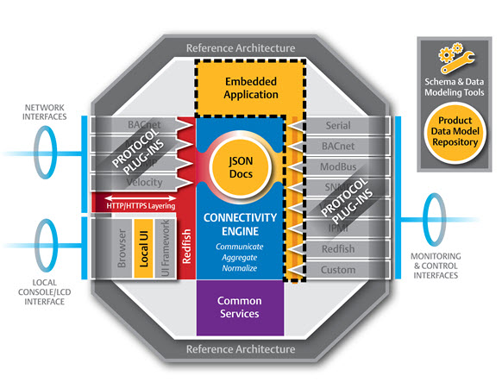

Background
DMTF released Redfish. Nagios Core is integrated with Redfish API to fetch system status.

Slide 8
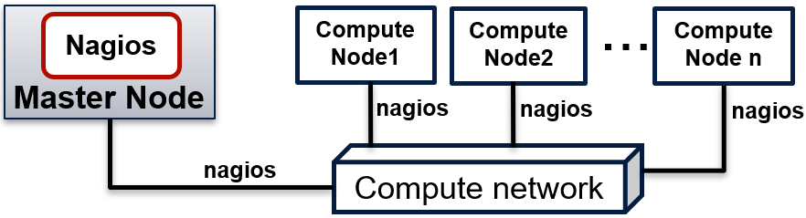
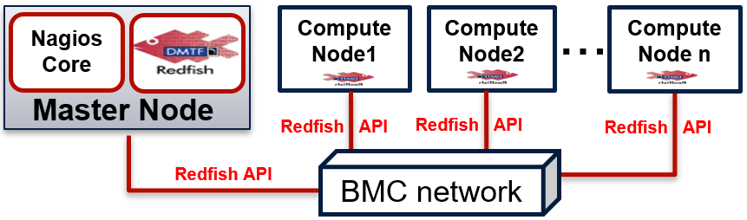
Integrating Redfish with Nagios
Nagios Using in-band Communication
Nagios Using out-of-band Communication

Slide 9
Deliverables and benefits
The following Redfish based plugins are developed
https://github.com/nsfcac/Nagios-Redfish-API-Integration
 | Hardware Health Check Plugins
 | Checking Baseboard Management Controller Health
 | Checking Host Health
 | Checking CPU Health
 | Checking Memory Health
 | Checking Fans Health
 | Checking PowerSupplies Health
HPC Infrastructure Health Monitoring using Redfish API and Nagios Core

Slide 10
Deliverables and benefits
The following Redfish based plugins are developed
https://github.com/nsfcac/Nagios-Redfish-API-Integration
 | Hardware Metric Monitoring Plugins
 | Monitoring Power Usage
 | Monitoring CPU Temperature
 | Monitoring Fans Speed
HPC Infrastructure Metrics Monitoring using Redfish API and Nagios Core

Slide 11
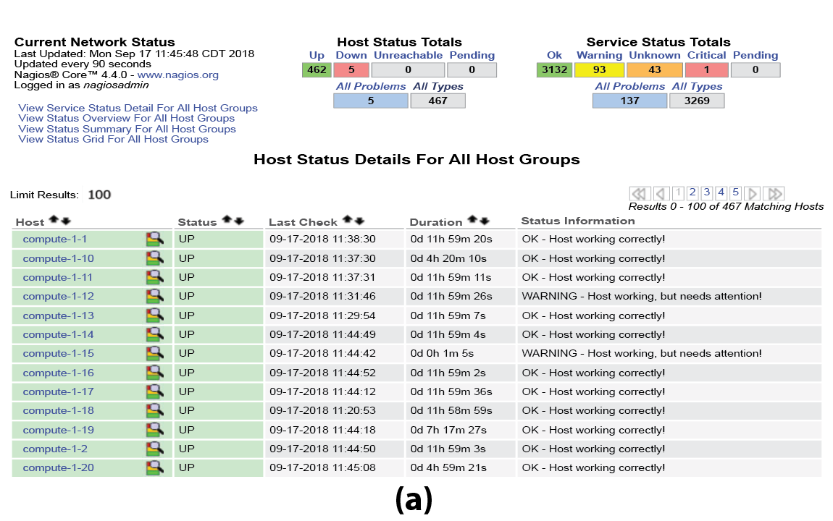
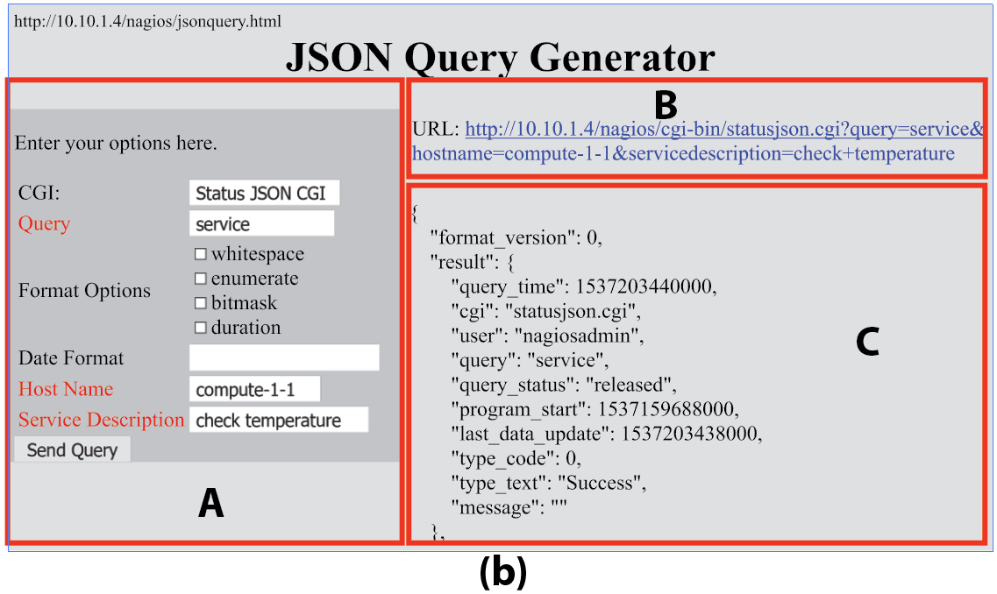
Background and Related Research
Notes:
a priori approach – instead of establishing a research question prior to performing an experiment, we let the data tell us which variables are important

Slide 12
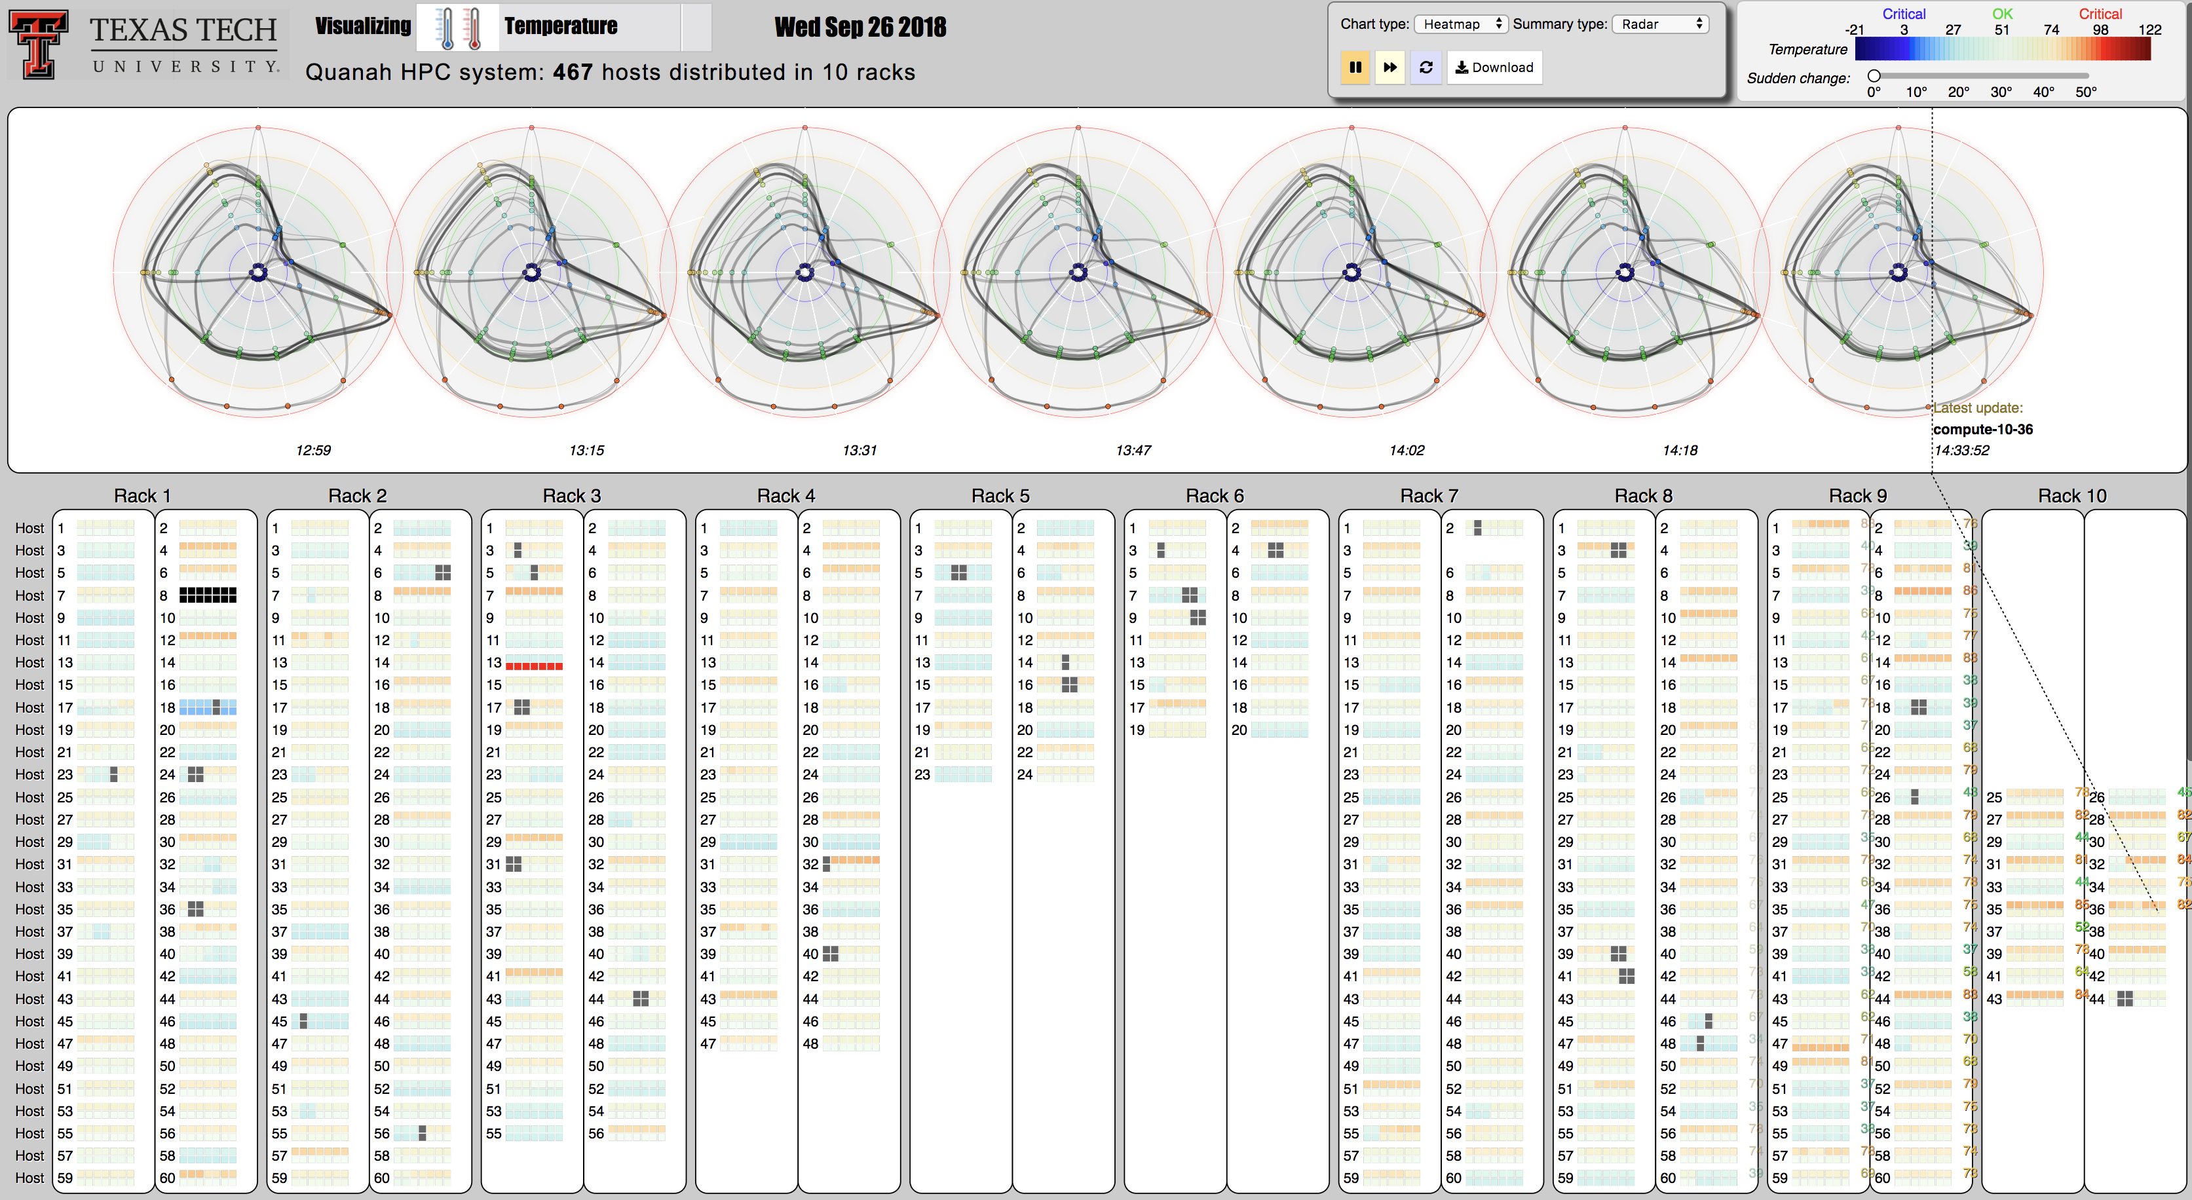
Background
Notes:
a priori approach – instead of establishing a research question prior to performing an experiment, we let the data tell us which variables are important

Slide 13

An initial interface has been developed
Scan the bar code using your phone camera to run our HPC visualization
HiperView:
https://idatavisualizationlab.github.io/HPCC/HiperView/demo.html
https://idatavisualizationlab.github.io/HPCC/HiperOverheatSep26/demo.html
Github repository:
https://github.com/iDataVisualizationLab/HPCC

Slide 14
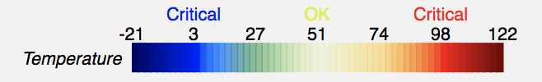
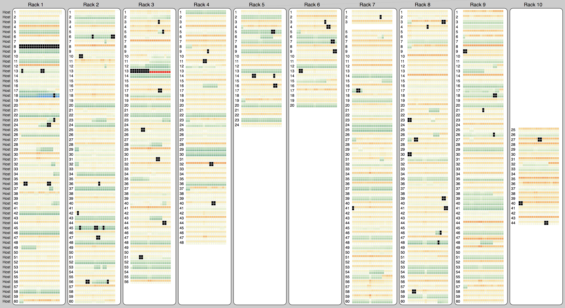
HPCC on Sep, 26 2018: CPU temperature

Slide 15
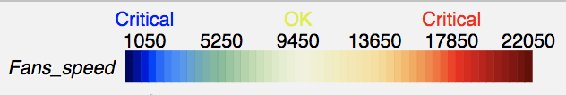
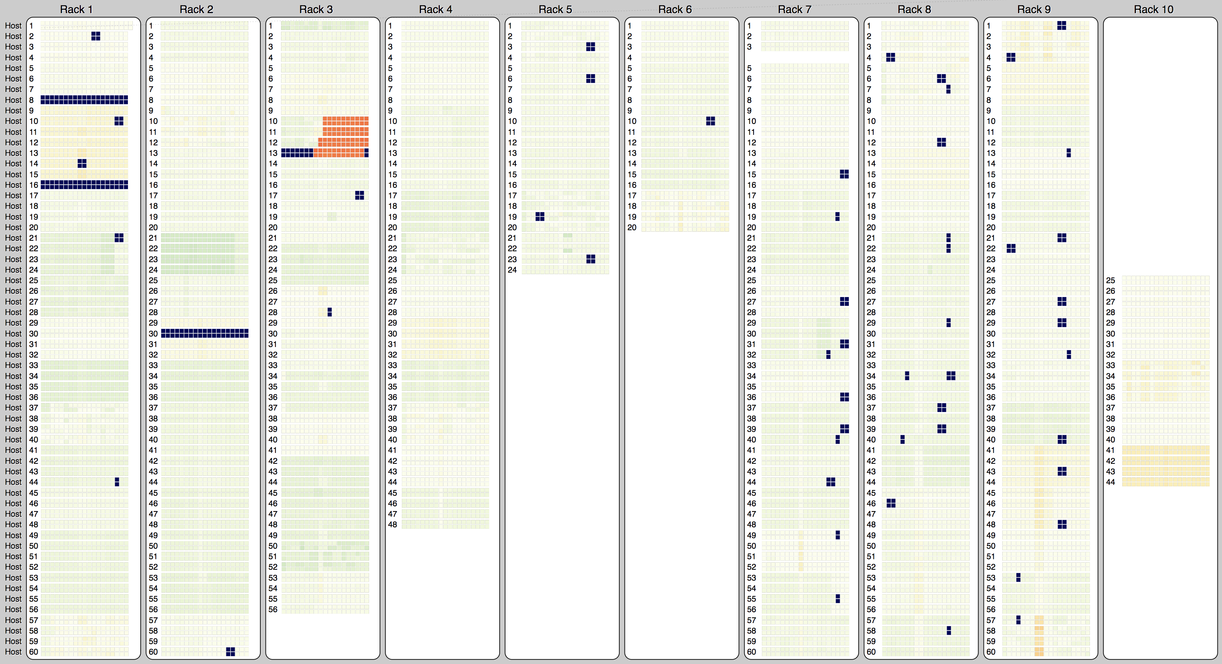
HPCC on Sep, 26 2018: Fan speed

Slide 16
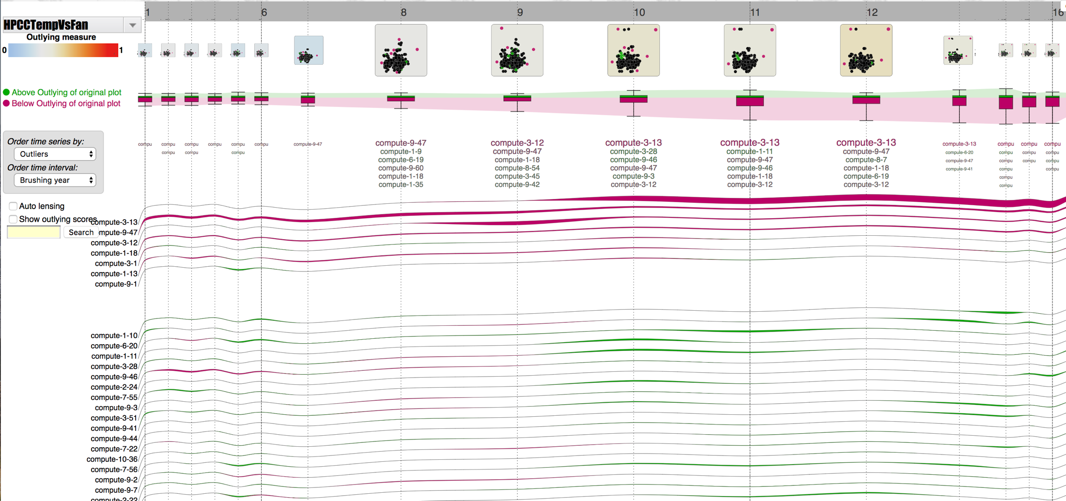
HPCC on Sep, 26 2018: CPU temperature vs Fan speed

Slide 17
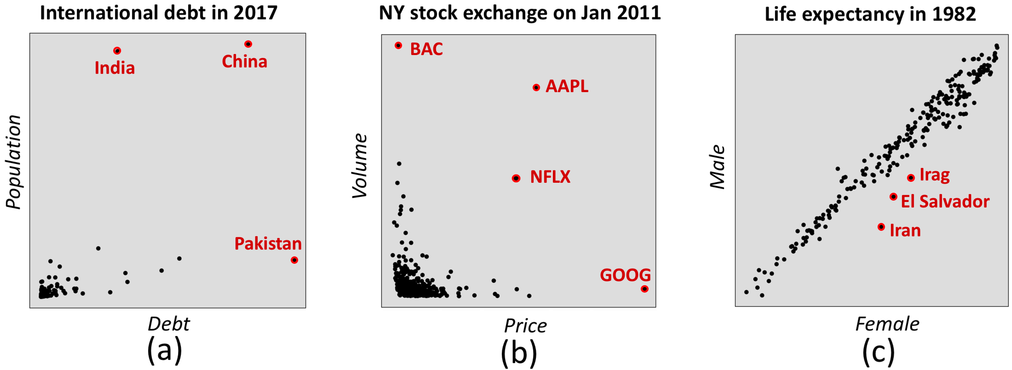
Multi-dimensional analytics
Why?

Slide 18
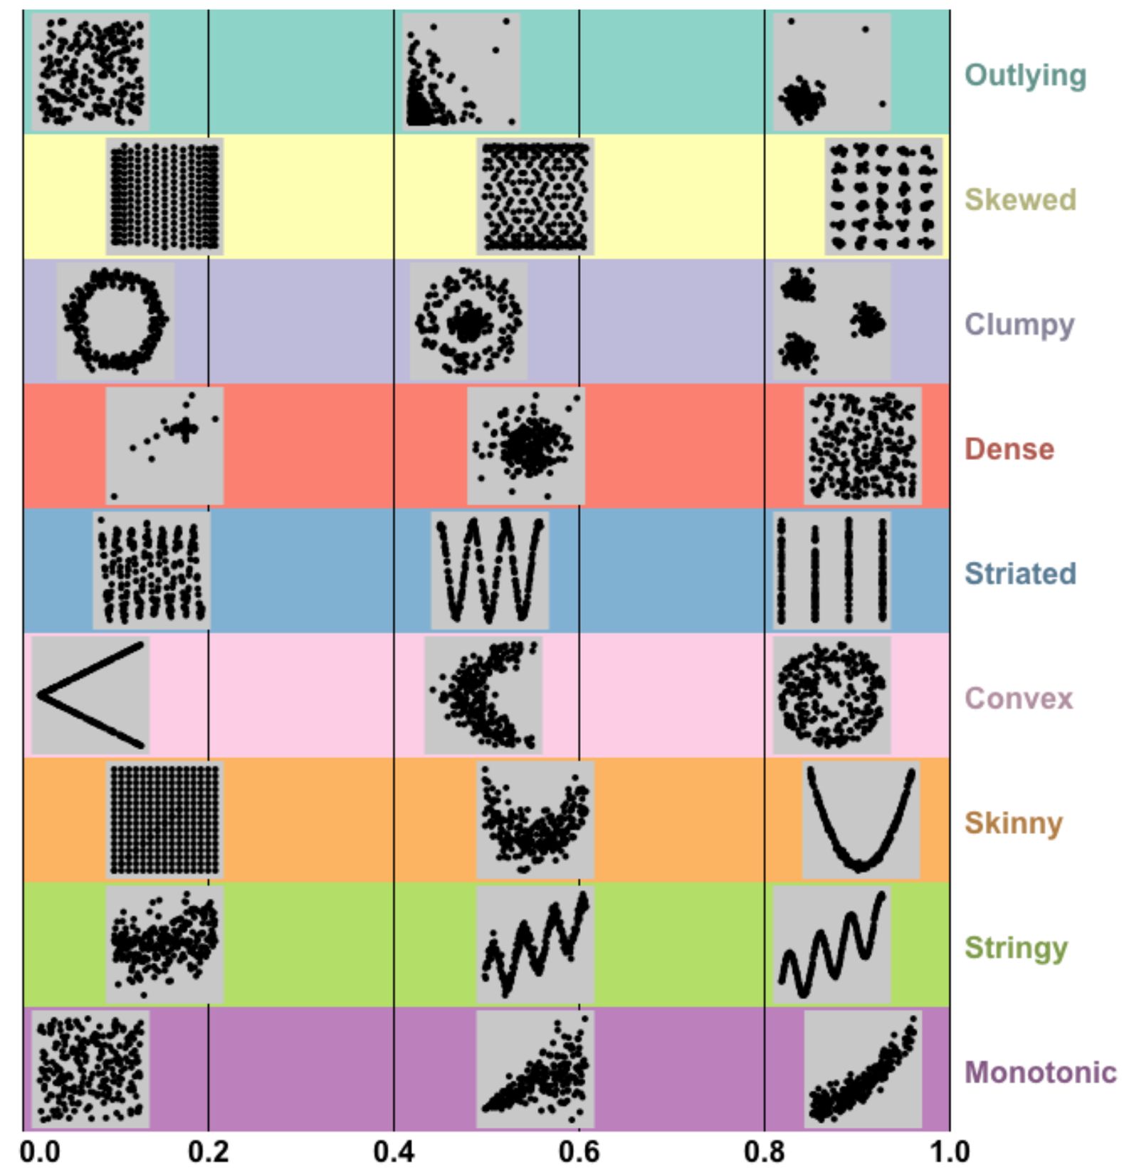
Multi-dimensional analytics

Slide 19
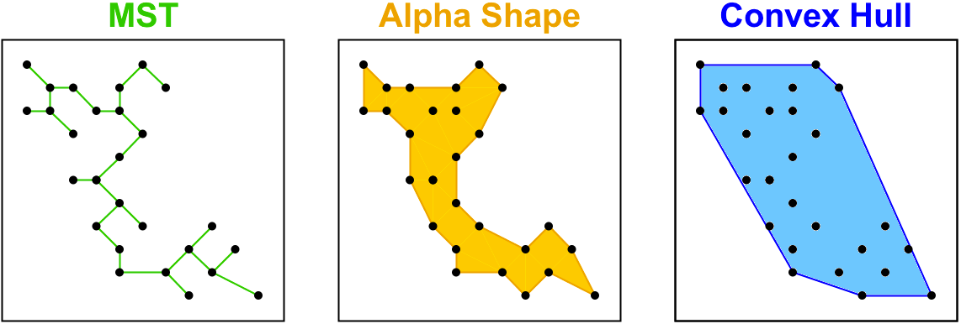
Multi-dimensional analytics

Slide 20

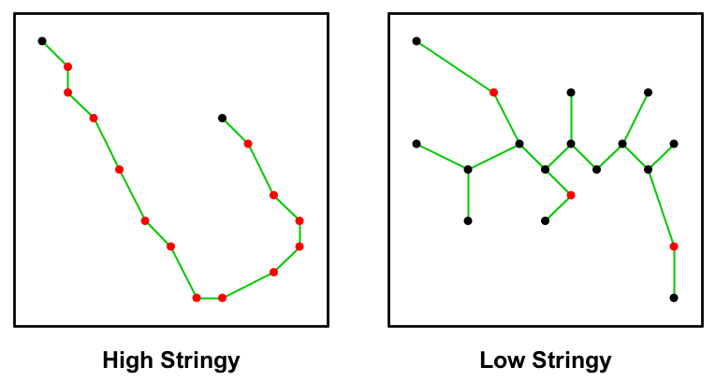
Multi-dimensional analytics

Slide 21
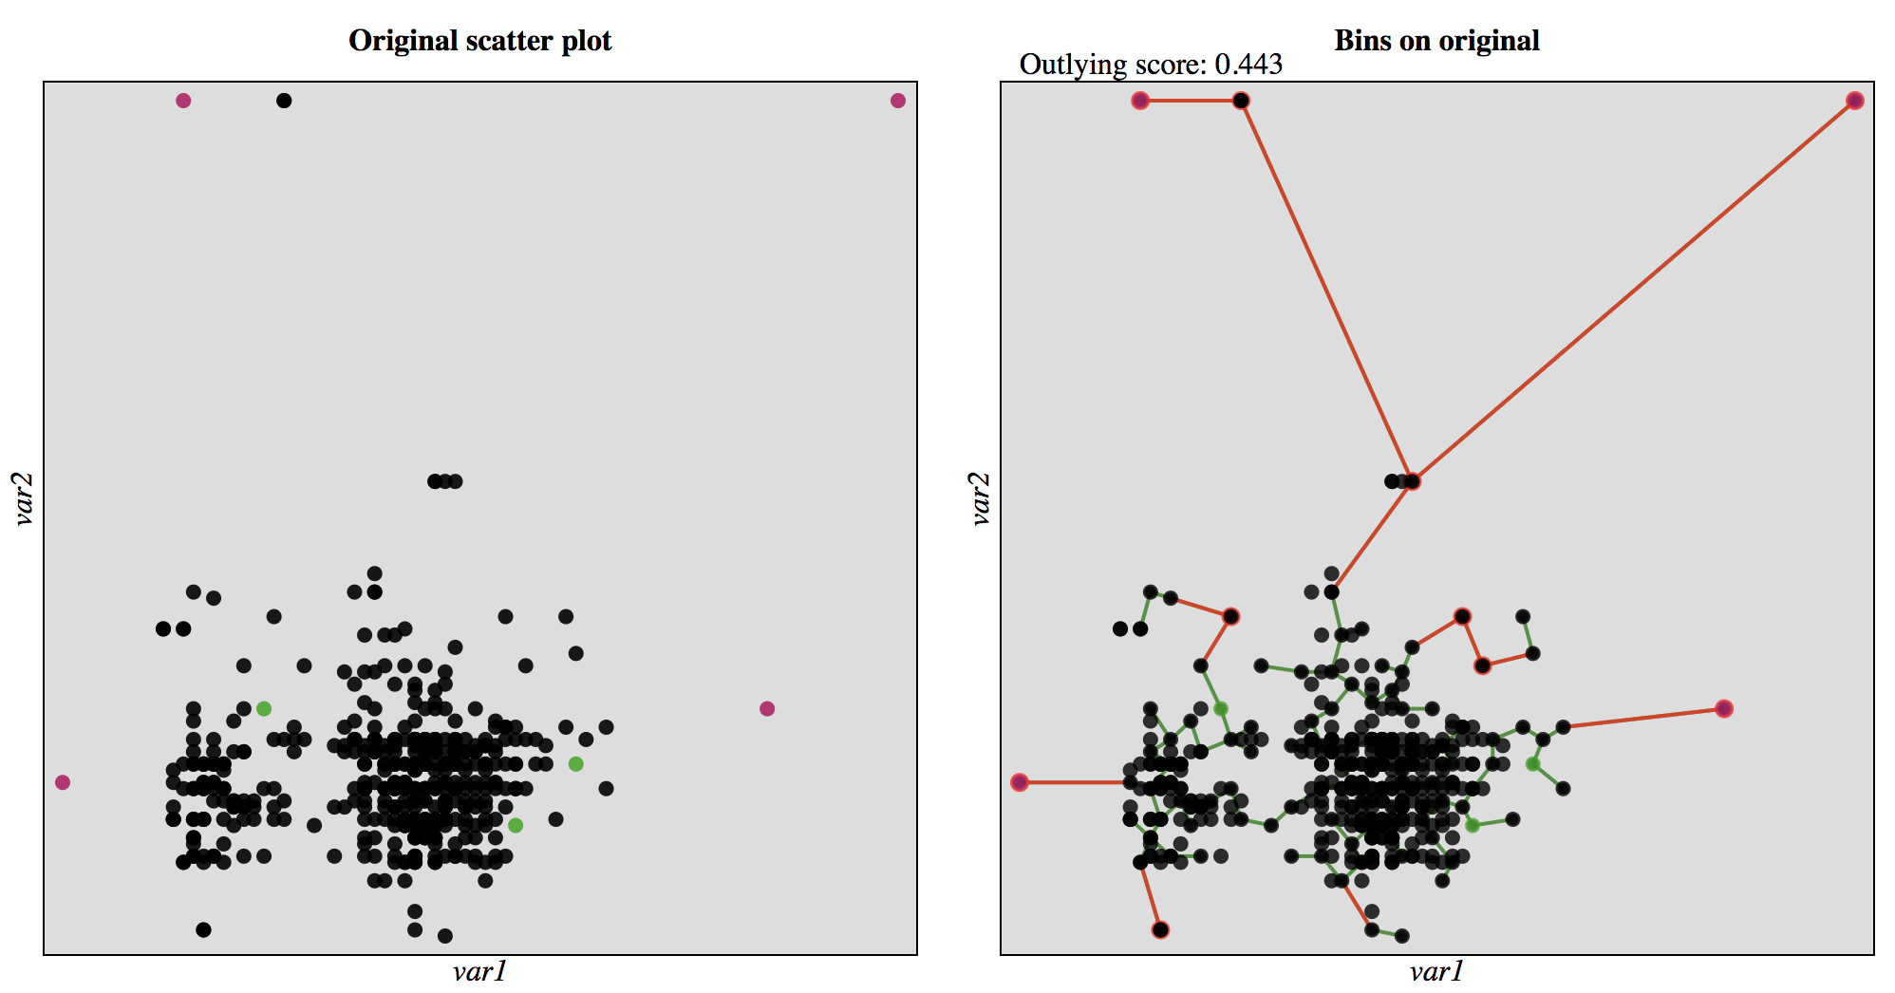
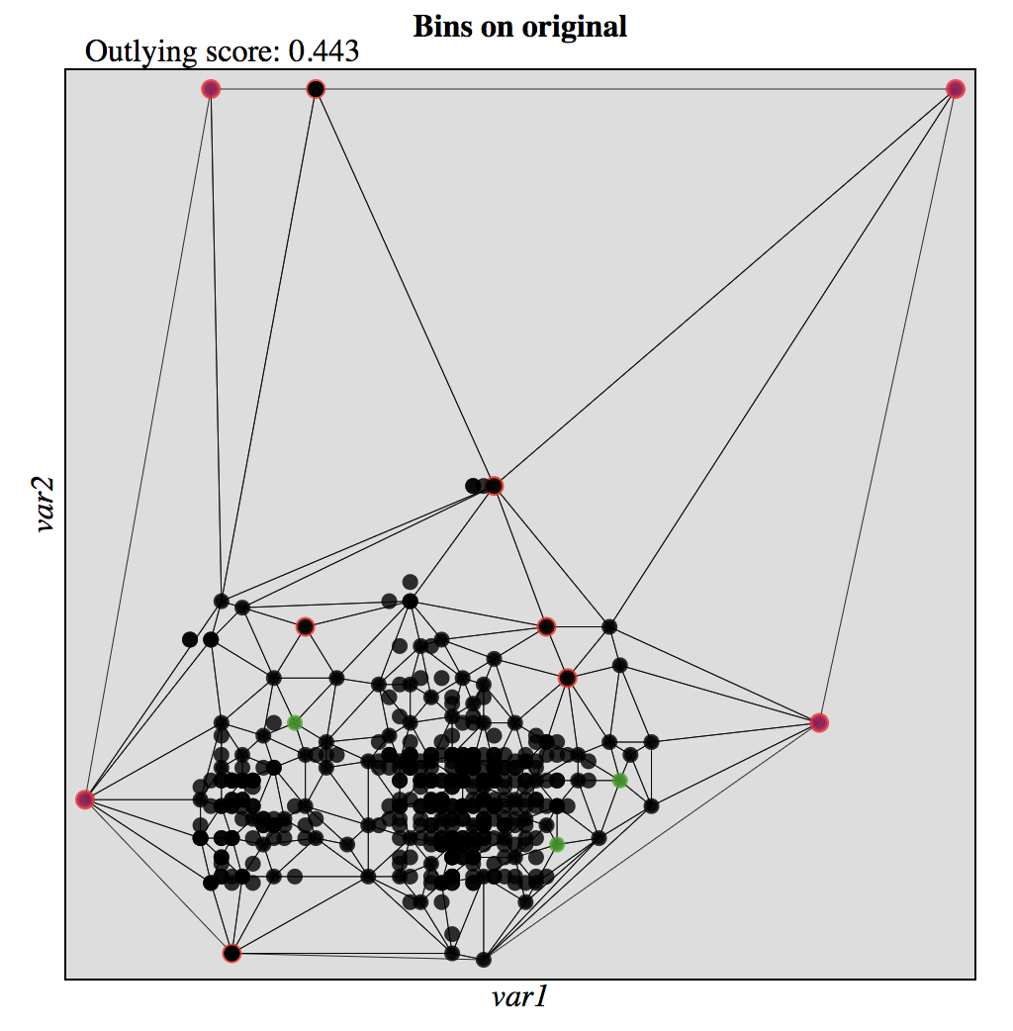
HPCC on Sep, 26 2018: CPU temperature vs Fan speed

Slide 22
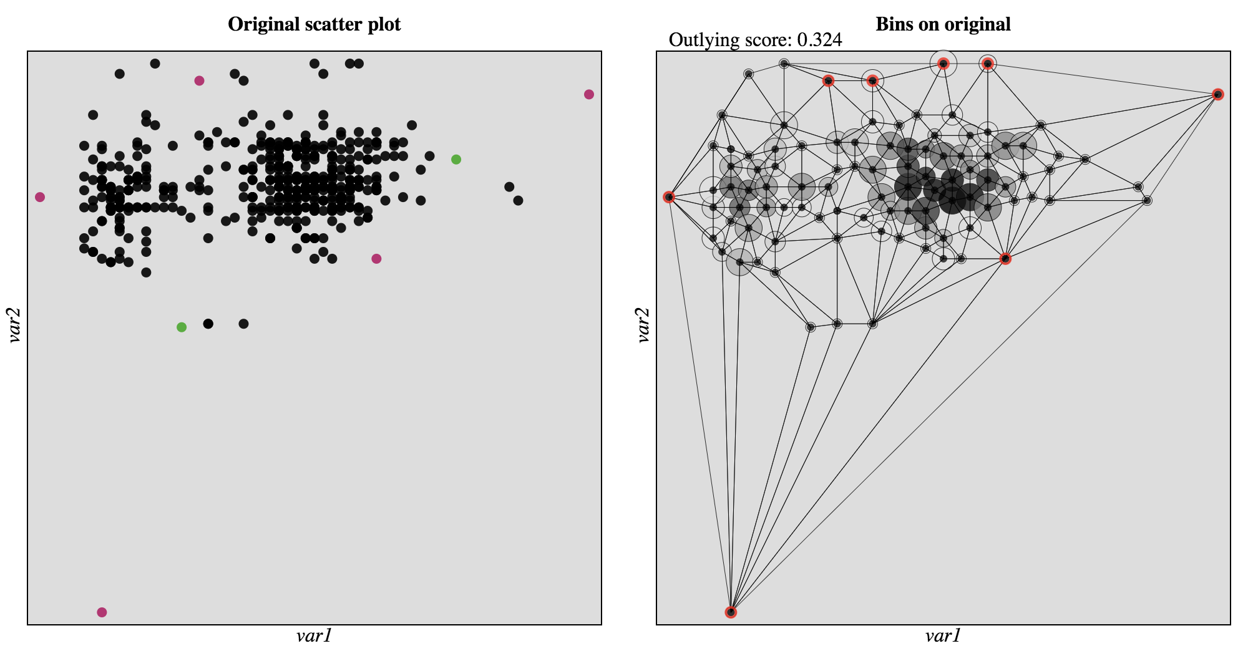
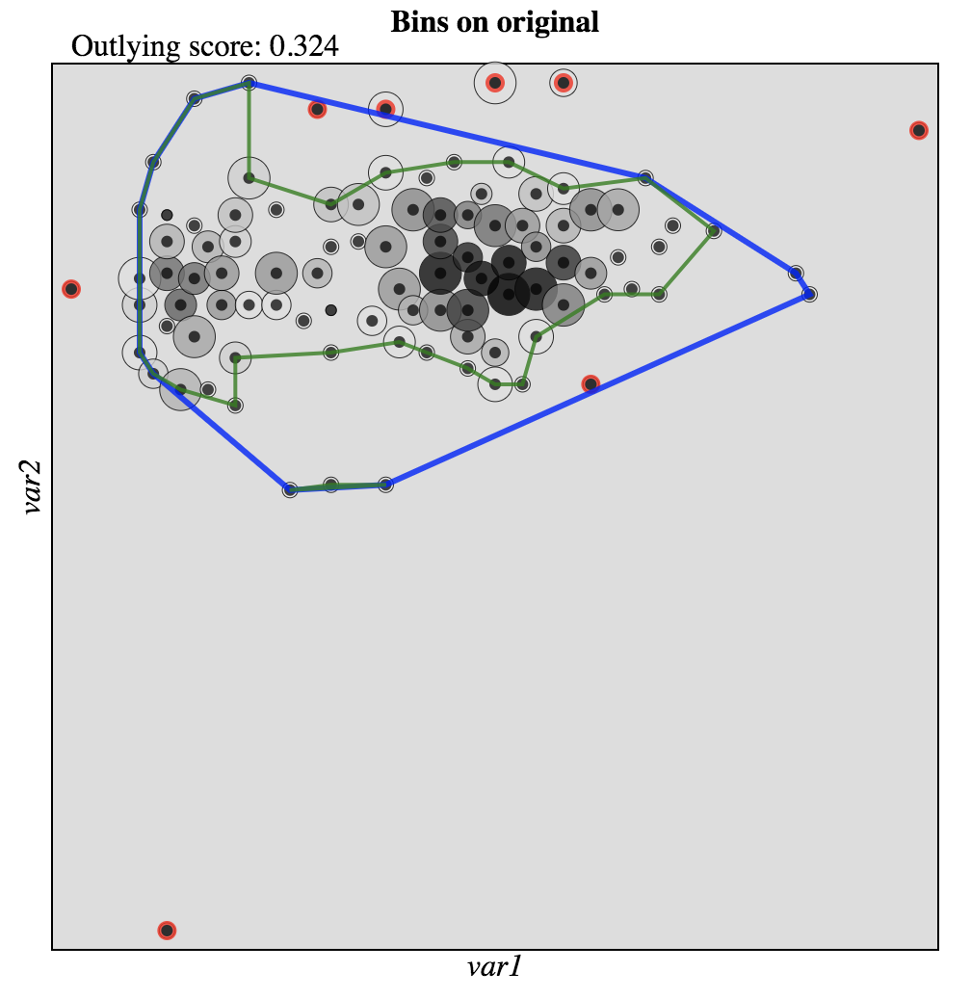
HPCC on Oct, 4 2018: CPU temperature vs Fan speed

Slide 23
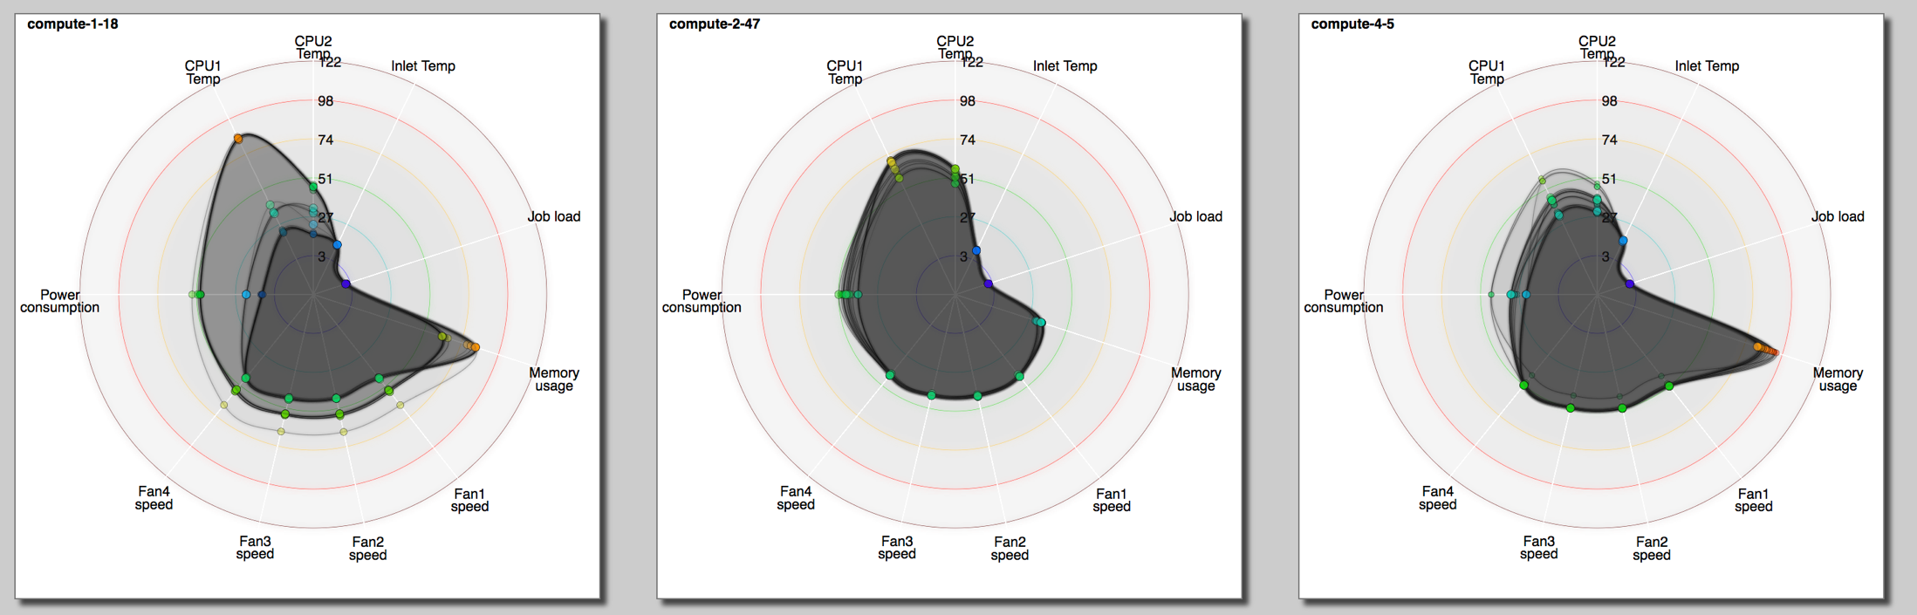
More than 2 dimensions?

Slide 24
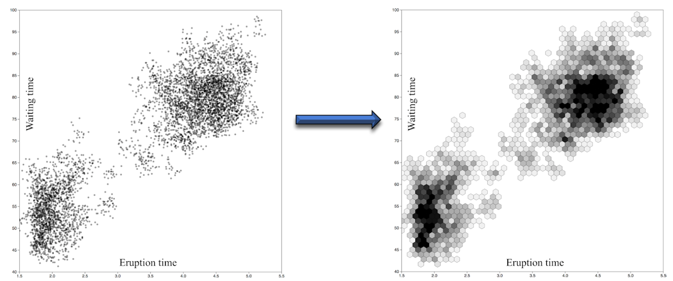
Too many data points?

Slide 25
Future Work

Slide 26
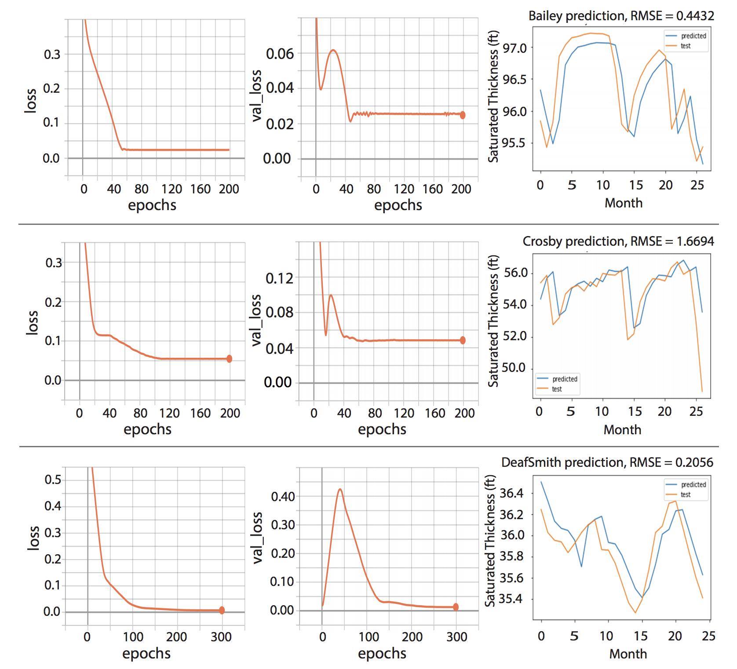
Predictive analytics
Vinh Nguyen, Fang Jin, and Tommy Dang
Predict Saturated Thickness using TensorBoard Visualization
The Visualization in Environmental Sciences

Slide 27
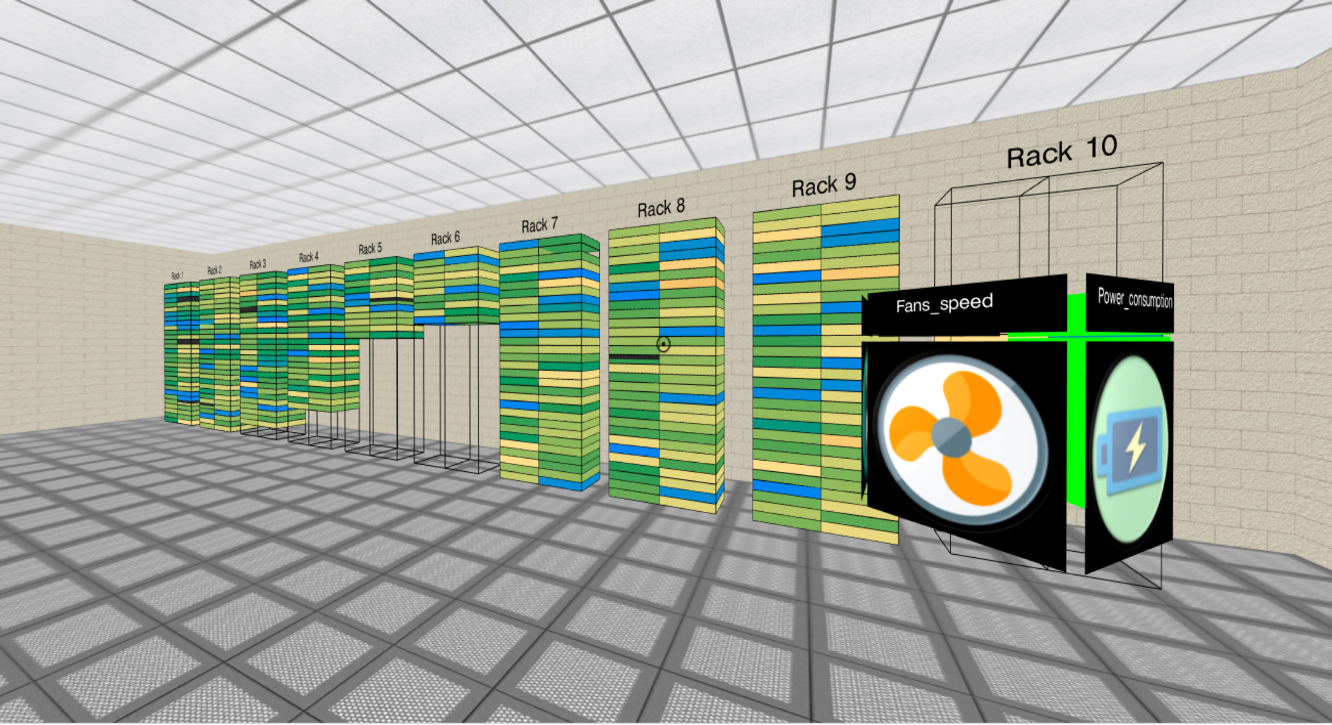


AR/VR

Slide 28
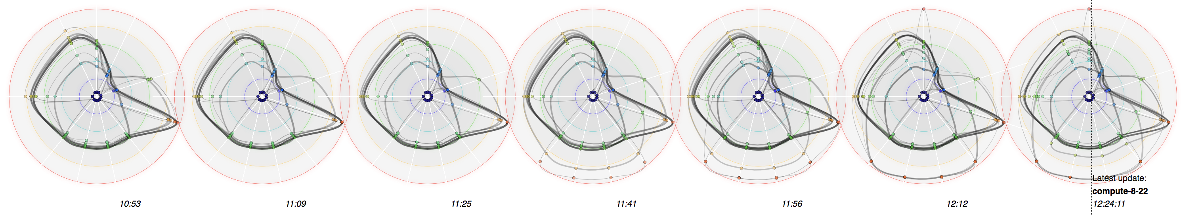

Questions?
Email: Tommy.Dang@ttu.edu

